Slide 1
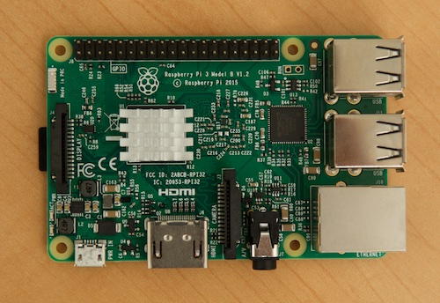
INSTALL A MULTIMEDIA SERVER WITH A RASPBERRY PI

Slide 2
SUMMARY
Material to have
SD card configuration
Installation steps
Libraries

Slide 3
MATERIAL TO HAVE
HDMI cable
WiFI connection
Mouse and Keyboard
(Optional)
Raspberry PI (≤ 3)
Power Supply
SD Card (≤ 8Go)
Raspberry protection

Slide 4
SD CARD CONFIGURATION
Download Raspbian OS
Extract the file
Insert SD card
Download his formatter

Slide 5
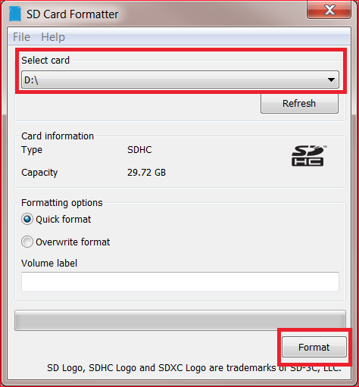
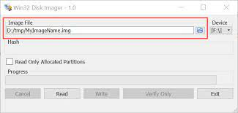
INSTALLATION : Step 1
Set the SD card format
Download Disk Imager
Select SD Card

Slide 6
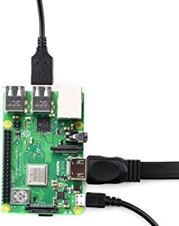
INSTALLATION : Step 2
Connect the components
Insert micro SD card
Put the power supply

Slide 7
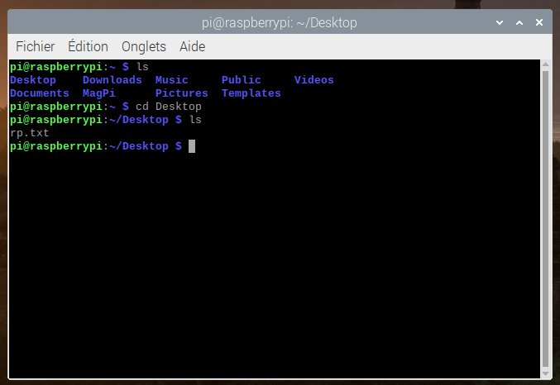
INSTALLATION : Step 3
Connect to WiFI
Launch terminal

Slide 8
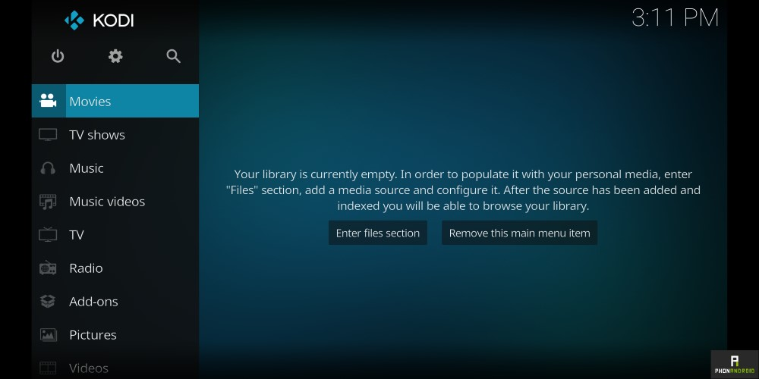
INSTALLATION : Step 4
Write : sudo apt-get install kodi
Then, write : sudo/nano/.../nano/kodi
Put : Enabled = 1
Execute kodi

Slide 9
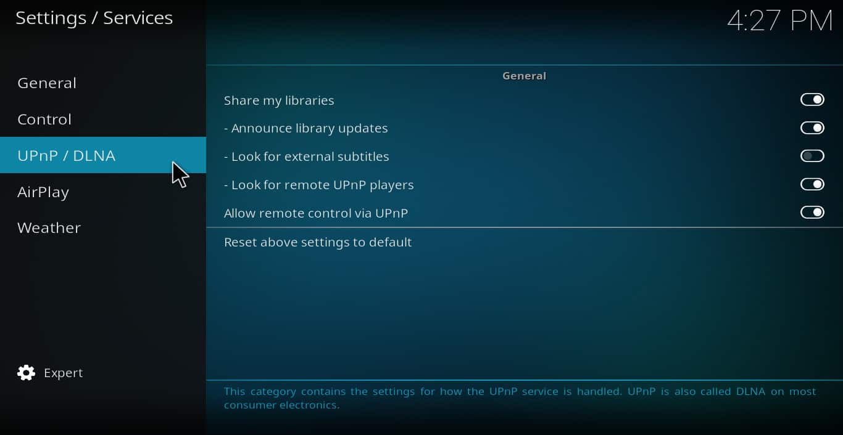
INSTALLATION : Step 5
Go to services settings
Activate : sharing over UpnP

Slide 10
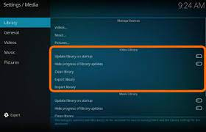
LIBRARIES
Add some libraries
Go to home menu
Put in your storage

Slide 11
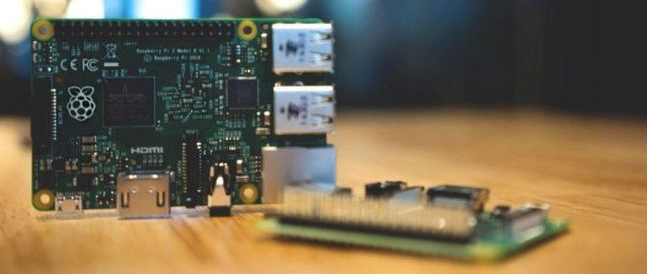
YOU ARE NOW BE ABLE TO INSTALL A MULTIMEDIA SERVER WITH A RASPBERRY PI

